Slide 1
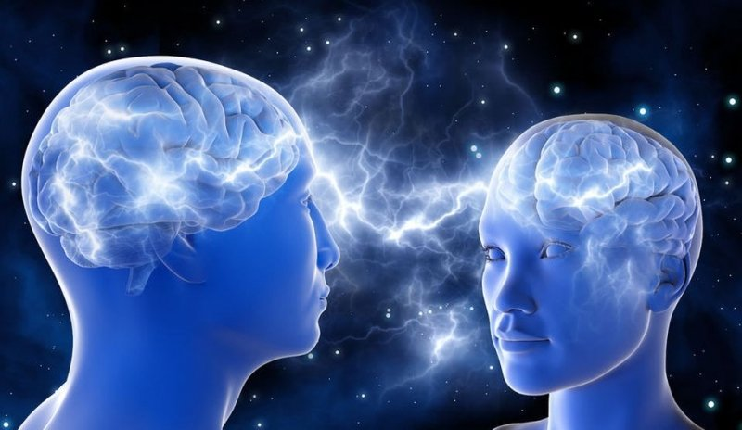
Telepathy
~ Rupam Kundu
Ritwik Maiti

Slide 2

How can we describe this phenomena?
Telepathy is nothing but an effect of Extrasensory Perception (ESP / Sixth sense).
Second sight is a form of extrasensory perception, the power to perceive things that are not present to the 5 senses, whereby a person perceives information, in the form of a vision.
There is no scientific evidence that second sight exist.

Slide 3


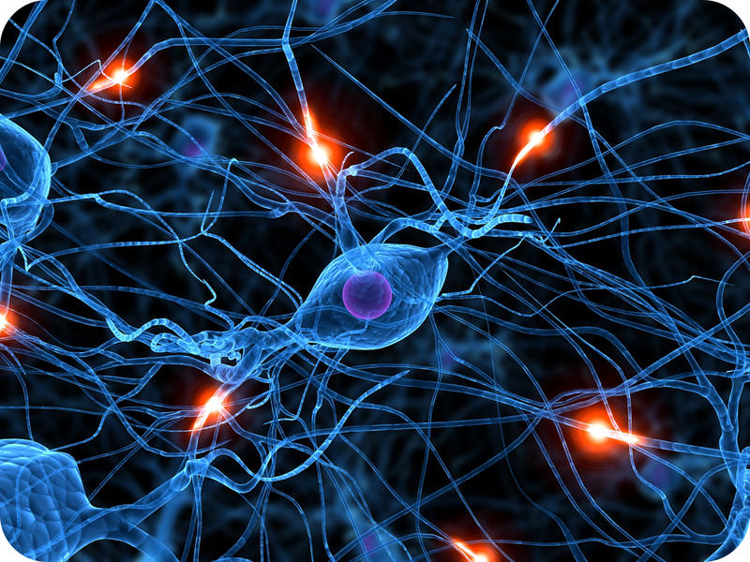
If scientific explanation is not there then what it can be !
We think it, as an effect of cell-to-cell communication (synaptic transmission), where chemical signals are passed between cells resulting in electrical spikes in the receiving cell.
Because cells are connected in a network, brain activity produces a synchronised pulse of electrical activity, which is called a “brain wave”.

Slide 4
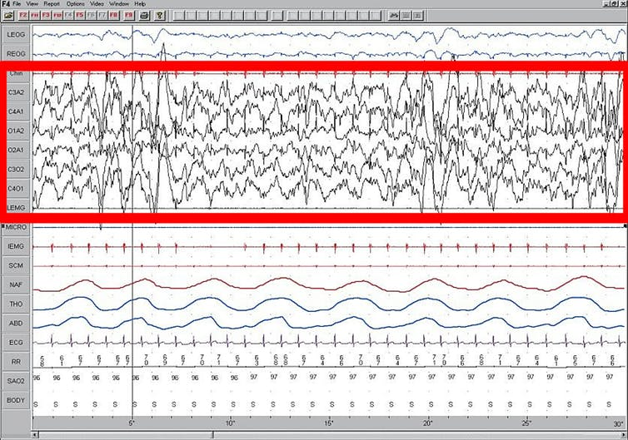
Brain waves change according to the cognitive processes that the brain is currently working through and are characterised by the time-frequency pattern of the up and down states (oscillations).
For example, there are brainwaves that are characteristic of the different phases of sleep, and patterns characteristic of various states of awareness and consciousness.

Slide 5
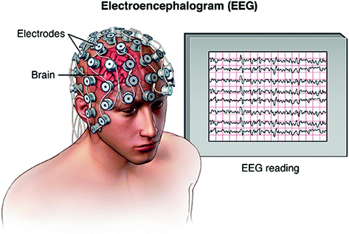
Brainwaves are detected using a technique known as electroencephalography (EEG), where a swimming-cap like device is worn over the scalp and electrical activity detected via electrodes. The pattern of activity is then recorded and interpreted using computer software.

Slide 6

So we see that, we can detect any signal coming from our brain.
But what about putting a new signal in the brain???
So, we can control a human body by that external signal.

Slide 7
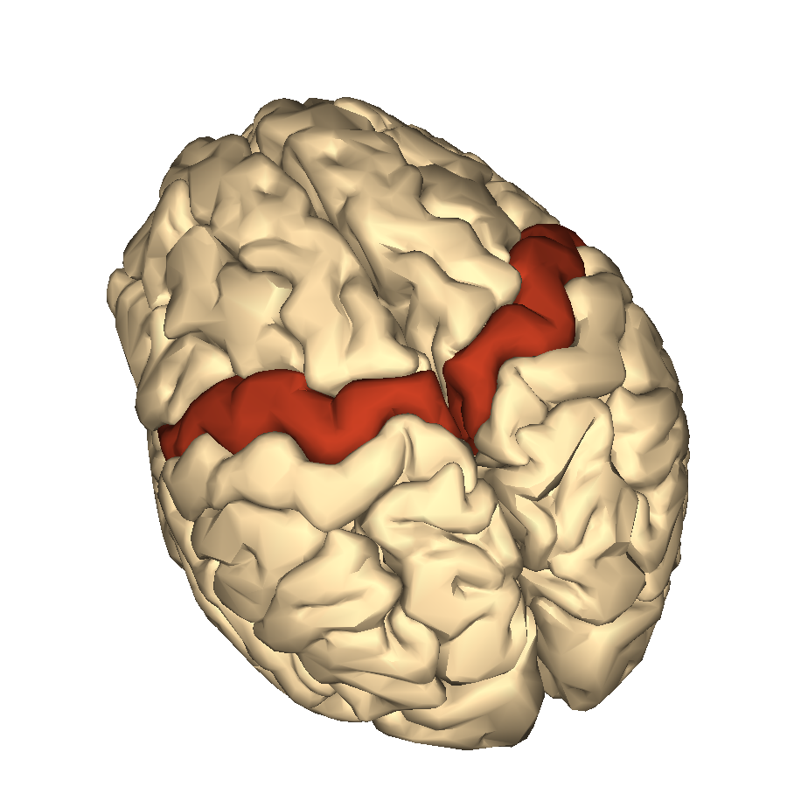
Motor cortex
The motor cortex is the region of the cerebral cortex involved in the planning, control, and execution of voluntary movements.
It is the main contributor to generating neural impulses that pass down to the spinal cord and control the execution of movement.
It has many proposed functions including the internally generated planning of movement, the planning of sequences of movement, and the coordination of the two sides of the body such as in bi-manual coordination.

Slide 8
“So, if we can change anyway, the function of the Motor Cortex and interpret with new signals, we can control them externally…”

Slide 9
Our Hypothesis
We think if generation of pulse is possible for our brain, then it is also possible to put an external signal in brain; and in this purpose we want to use the concept of the working of Motor Cortex region of the brain.

